Slide 1
Leveling up data:
Upgrade from EF6 to EF7 and blast off!

Slide 2


The .NET Data Team
Arthur Vickers
@ajcvickers
Principal Engineering Manager for Entity Framework and .NET Data at Microsoft
Shay Rojanksy
@shayrojansky
Principal Engineer on data access and performance at Microsoft
Lead dev of Npgsql, the PostgreSQL provider for .NET.
Showing the work of the .NET Data team at Microsoft:
Andriy Svyryd | @andriysvyryd
Brice Lambson | @bricelambs
Maurycy Markowski | @_MaurycyM_
Smit Patel | @smitpatel
And all our community contributors.

Slide 3
Entity Framework Core 7 (EF7)
Major new features
JSON columns
Bulk updates and deletes
Faster SaveChanges
Table-per-concrete-type (TPC) inheritance mapping
Custom T4 templates for Database First
Stored procedure mapping for insert/update/delete
New and improved interceptors and events
Plus many smaller enhancements and bug fixes
167 enhancements
171 bug fixes

Slide 4
Let’s code!

Slide 5
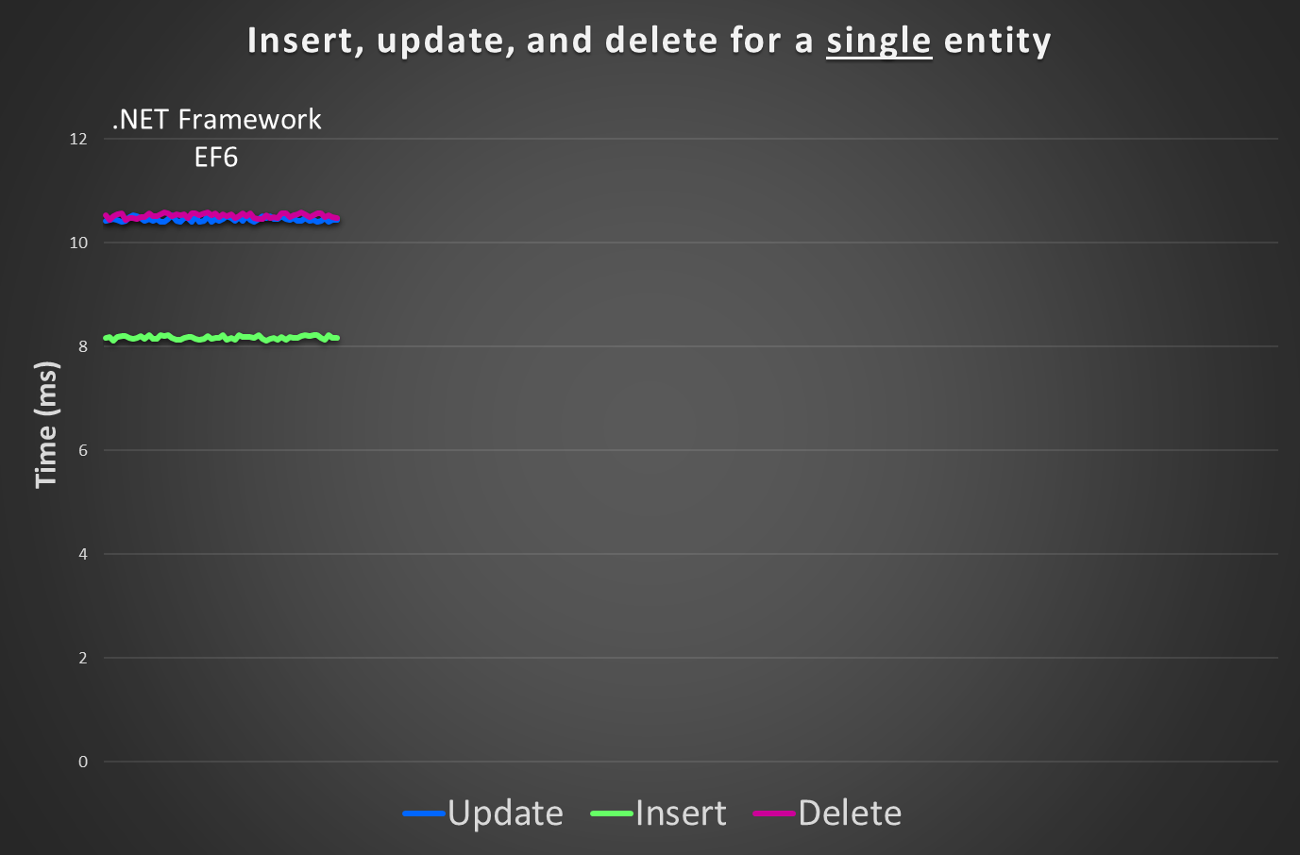

Slide 6
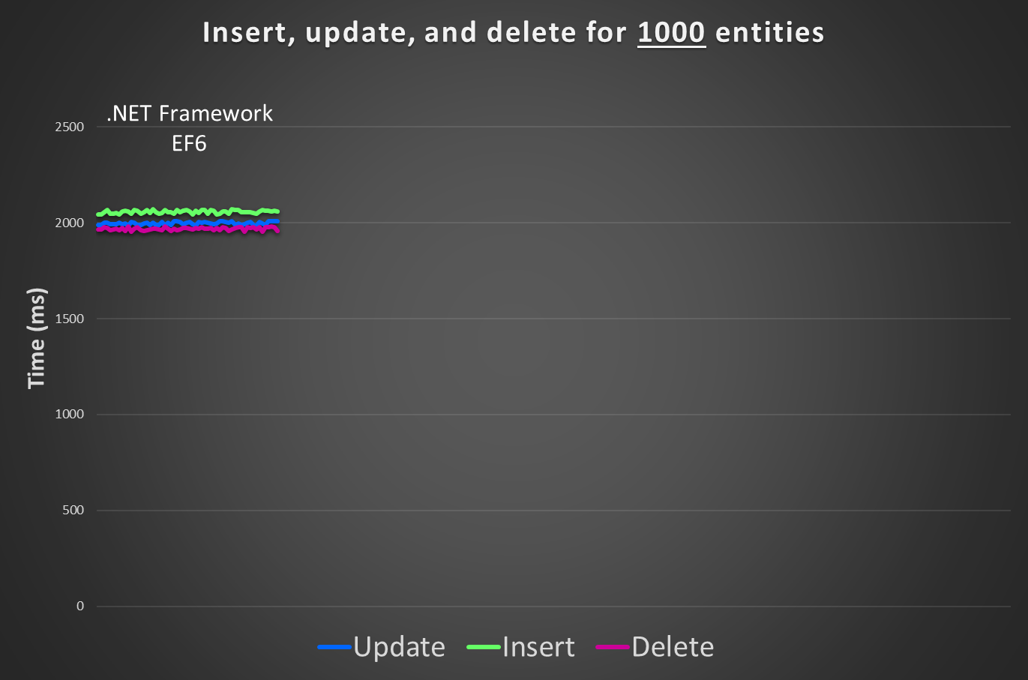

Slide 7
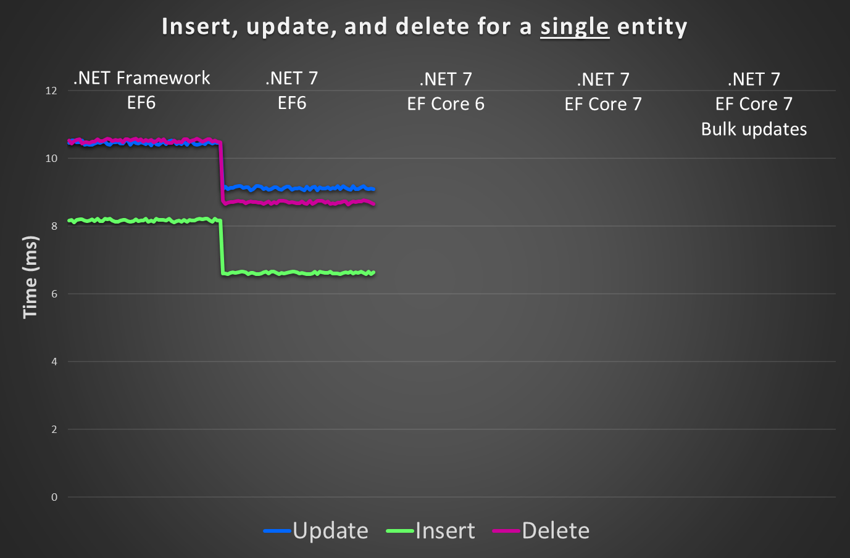
Update: 1.1x
Delete: 1.2x
Insert: 1.2x

Slide 8
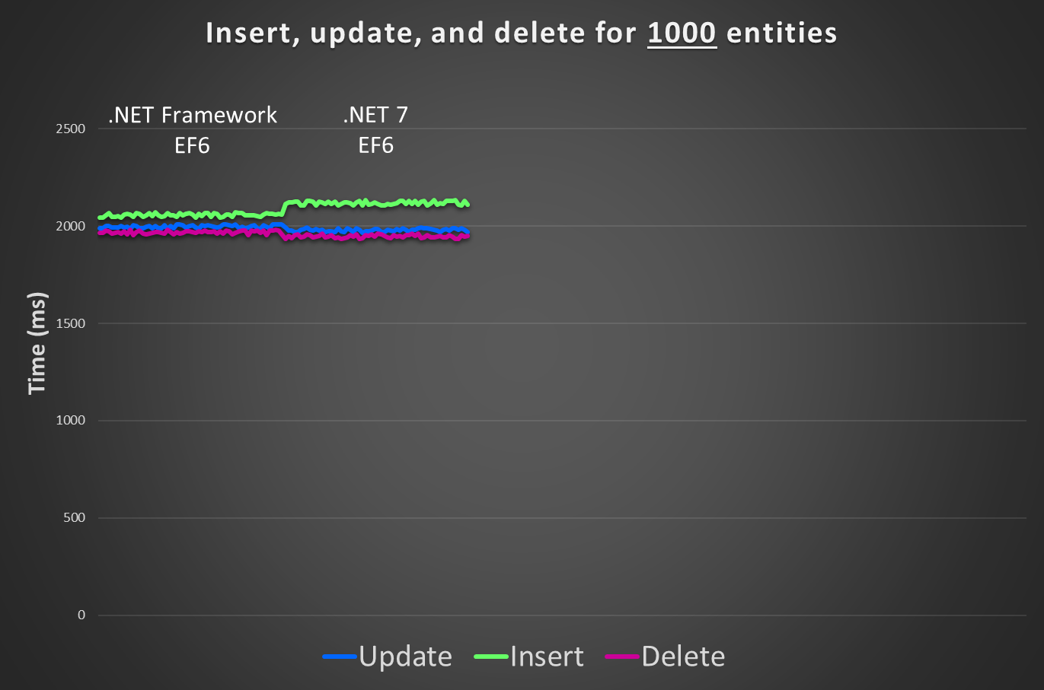

Slide 9
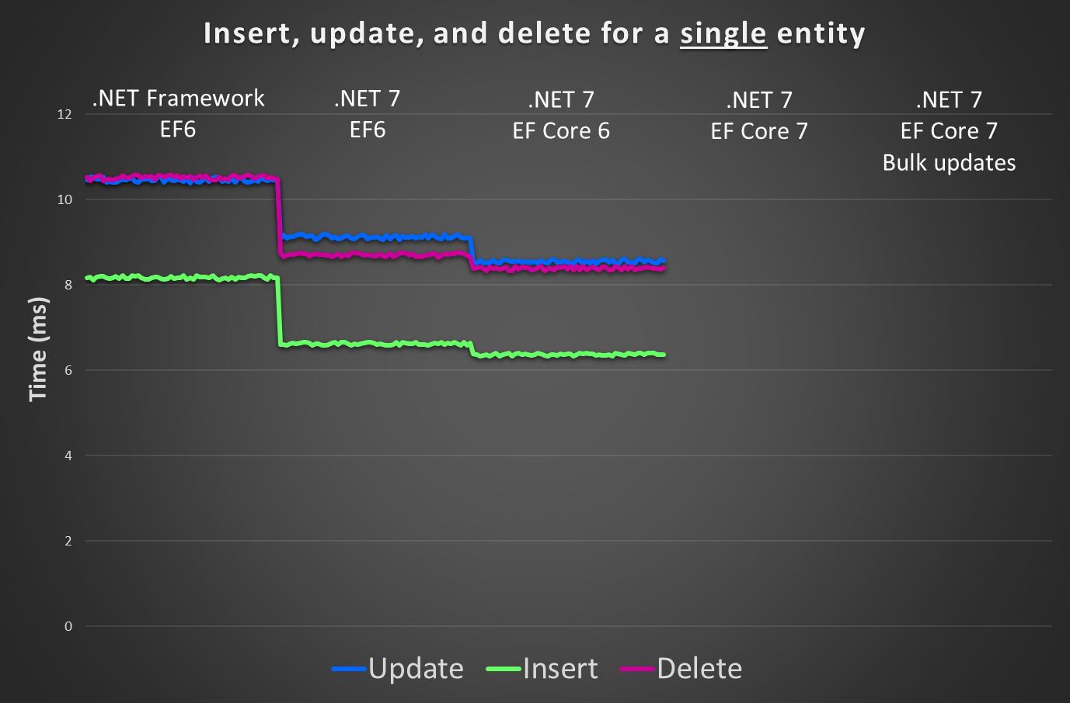
Update: 1.1x
Update: 1.8x

Slide 10
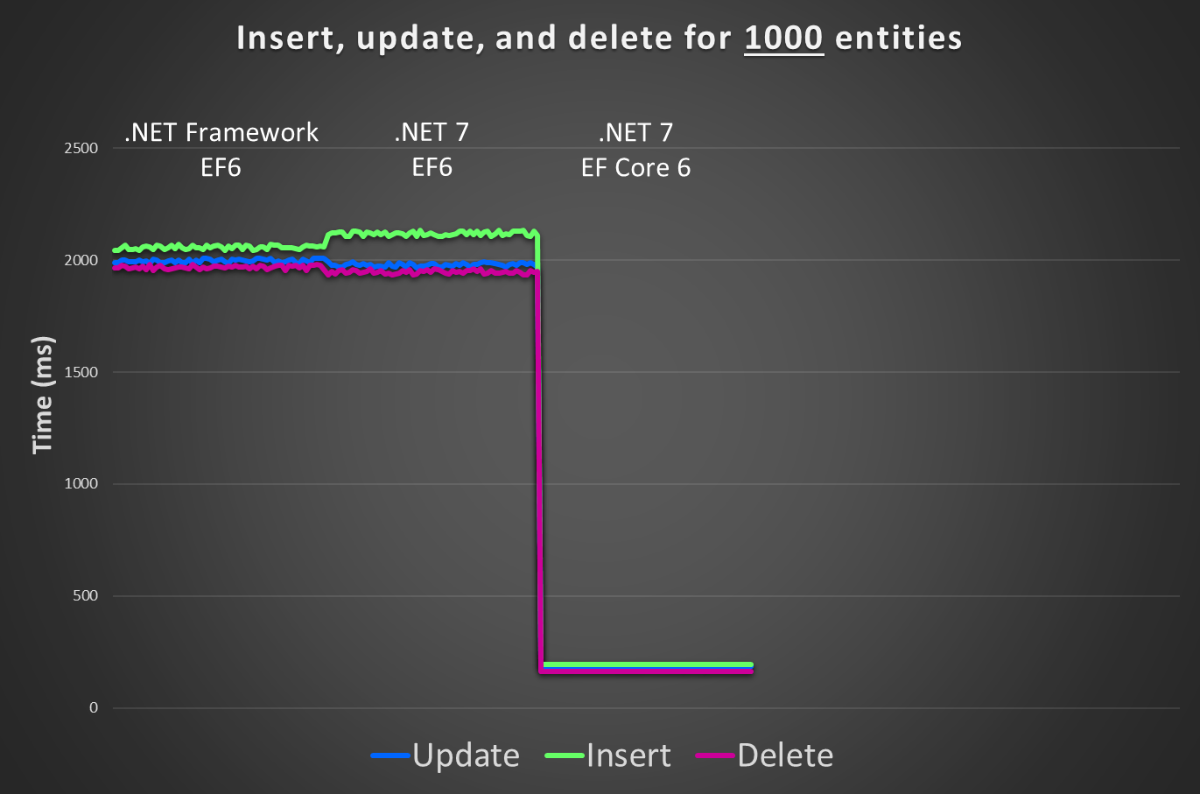
Update: 10x
Insert: 11x
Delete: 12x

Slide 11
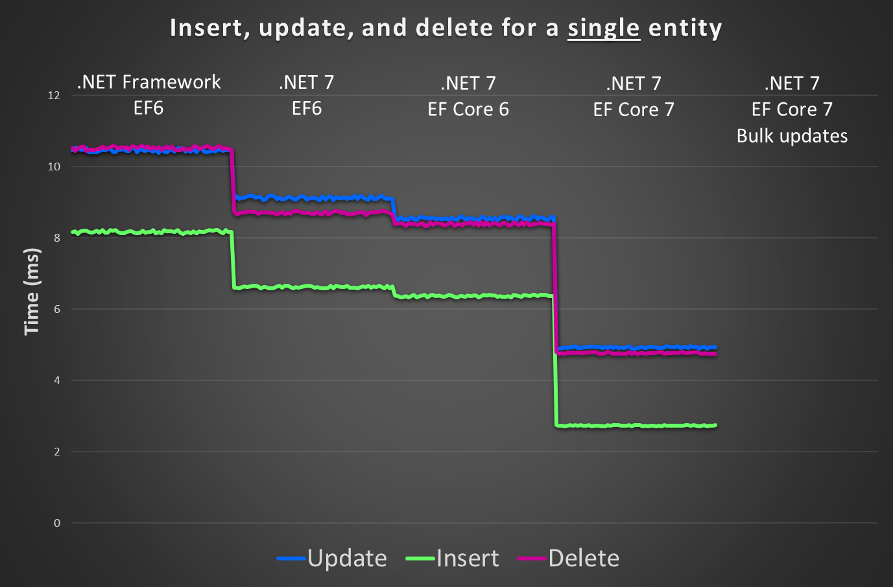
Update: 1.7x
Delete: 1.8x
Insert: 2.3x

Slide 12
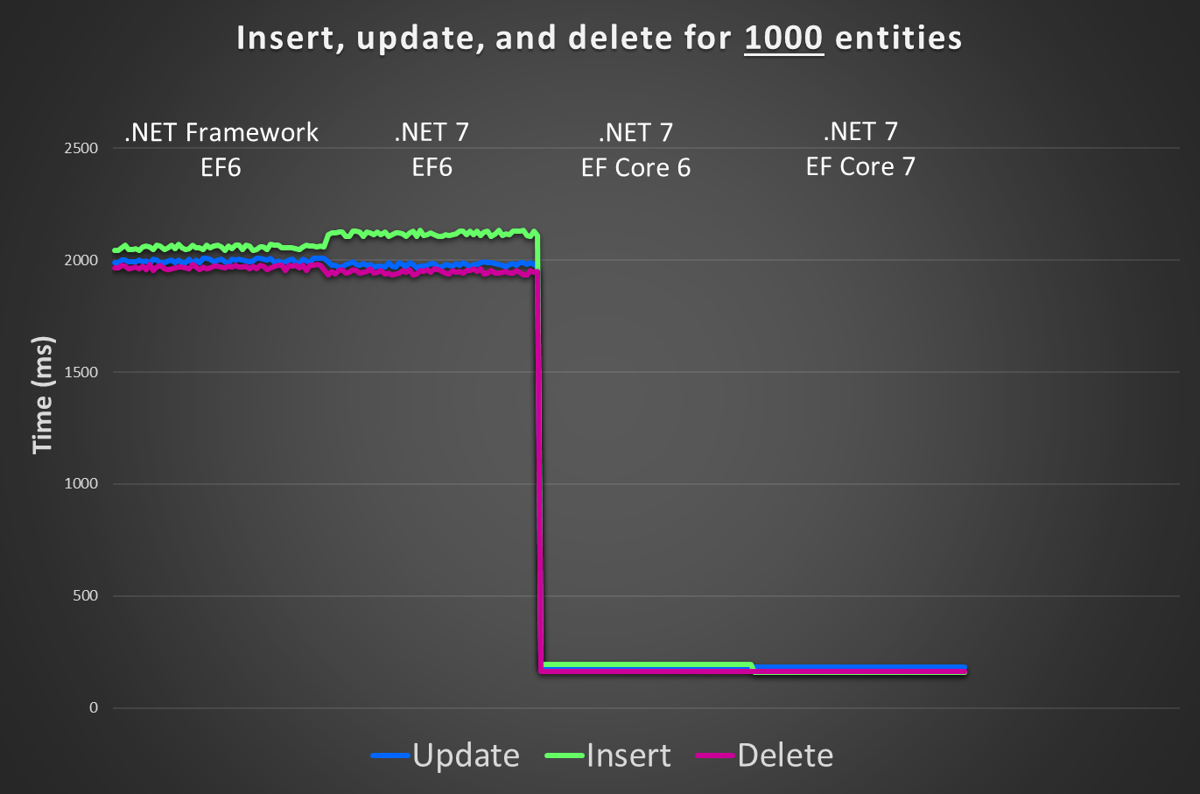

Insert: 1.2x

Slide 13
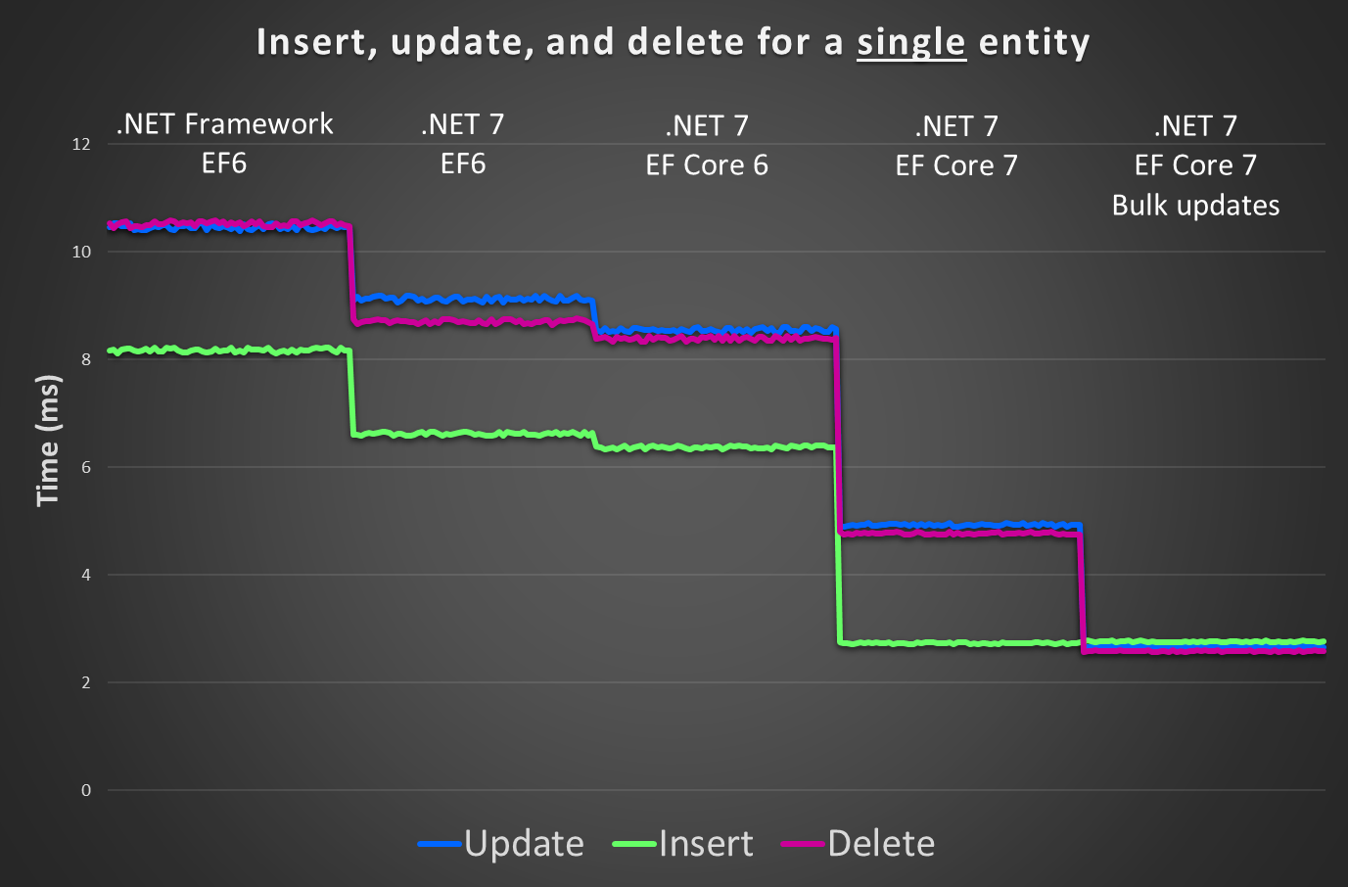
Delete: 1.8x
Update: 1.8x

Slide 14
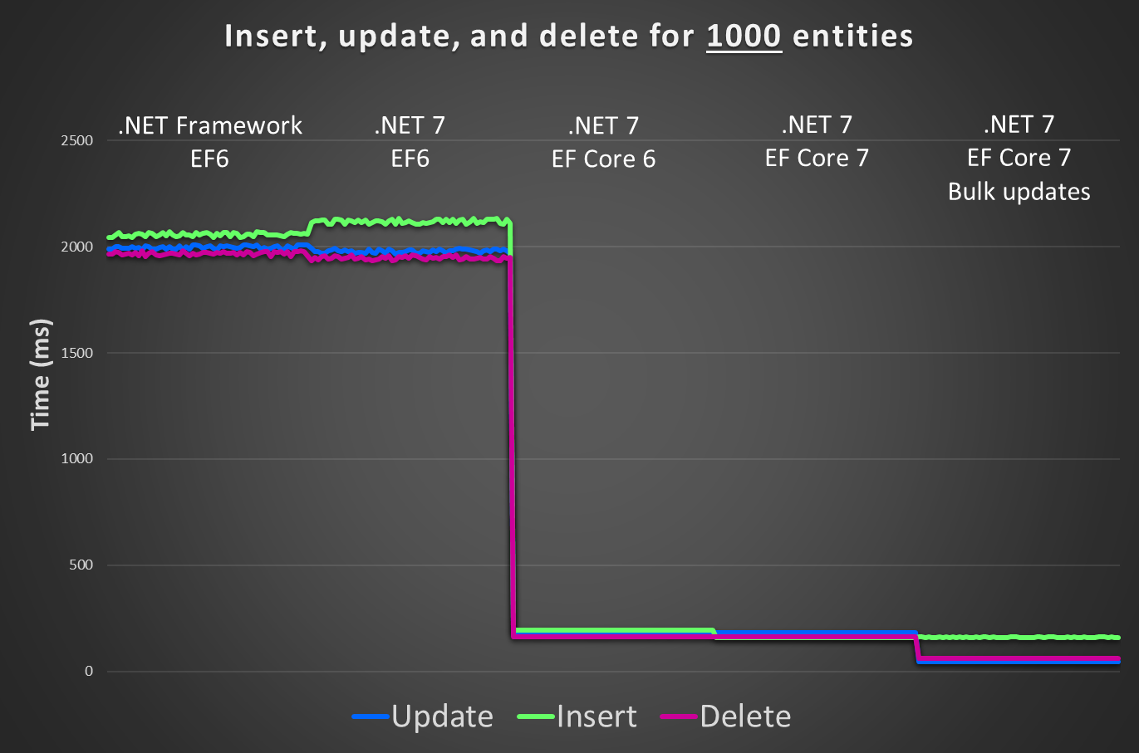
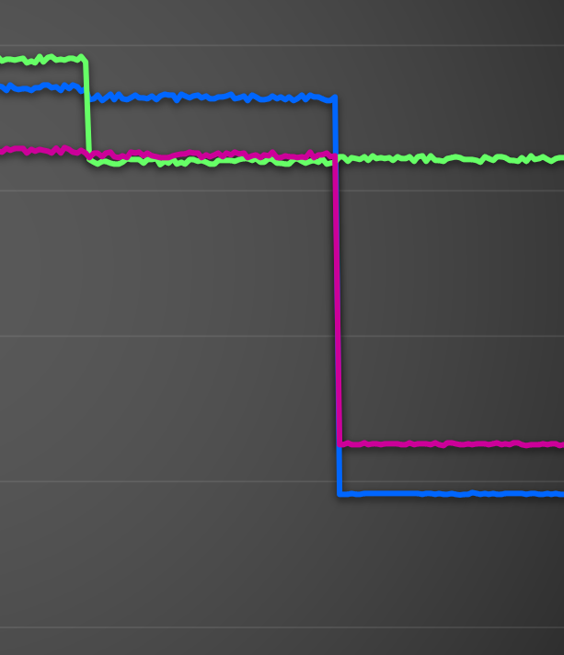
Delete: 2.6x
Update: 4.0x

Slide 15
.NET Framework with EF6 → .NET 7 with EF Core 7
Single entity | Gain | Using bulk
Insert | 3.0x | 3.0x
Update | 2.1x | 3.9x
Delete | 3.0x | 4.1x
Query | 1.5x | 1.5x
1000 entities | Gain | Using bulk
Insert | 13x | 13x
Update | 11x | 44x
Delete | 12x | 31x
Query | 1.7x | 1.7x

Slide 16
Thanks!
The code…
WebAPI: github.com/ajcvickers/BlogManagementApi
Tests and benchmarking: github.com/ajcvickers/BlogManagementClient
Find out more…
What’s New in EF7: aka.ms/efcore-whats-new
Community Standup: aka.ms/efstandups
EF documentation: aka.ms/efdocs
EF Core on GitHub: github.com/dotnet/efcore
Follow us…
Arthur Vickers: @ajcvickers
Shay Rojansky: @shayrojansky
Join us on the next .NET Data Community Standup: Wednesday, Nov 16 at 10AM Pacific A whirlwind tour of EF7 features!

